Slide 1
Chapter 23
Simple Network
Management Protocol
(SNMP)

Slide 2
CONTENTS
CONCEPT
MANAGEMENT COMPONENTS
SMI
MIB
SNMP
MESSAGES
UDP PORTS
SECURITY

Slide 3
23.1
CONCEPT

Slide 4
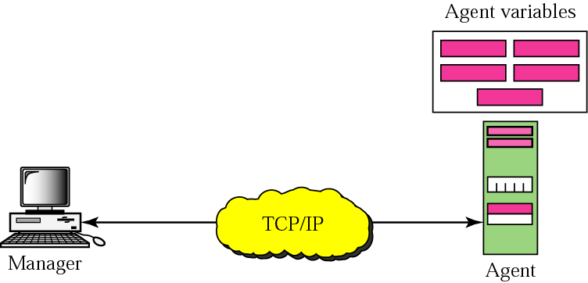
Figure 23-1
Concept

Slide 5
23.2
MANAGEMENT
COMPONENTS

Slide 6
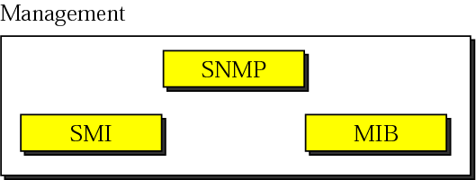
Figure 23-2
Components of network
management on the Internet

Slide 7

SNMP defines the format of packets
exchanged between a manager and
an agent.
It reads and changes the status
(values) of objects (variables) in
SNMP packets.

Slide 8
SMI defines the general rules for naming
objects, defining object types
(including range and length),
and showing how to
encode objects and values.

Slide 9
SMI defines neither the
number of objects an entity
should manage,
nor names the
objects to be managed nor
defines the association between
the objects and their values.

Slide 10
MIB creates a collection of named objects,
their types, and their relationships
to each other in
an entity to be managed.

Slide 11
We can compare the task of network
management to the task of writing
a program.
1. Both tasks need rules. In network
management this is handled by SMI.
2. Both tasks need variable declarations.
In network management this is handled
by MIB.
3. Both tasks have actions performed by
statements.In network management this is
handled by SNMP.

Slide 12
23.3
SMI

Slide 13
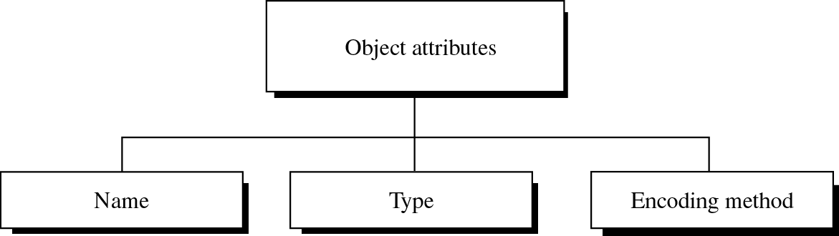
Figure 23-3
Object attributes

Slide 14
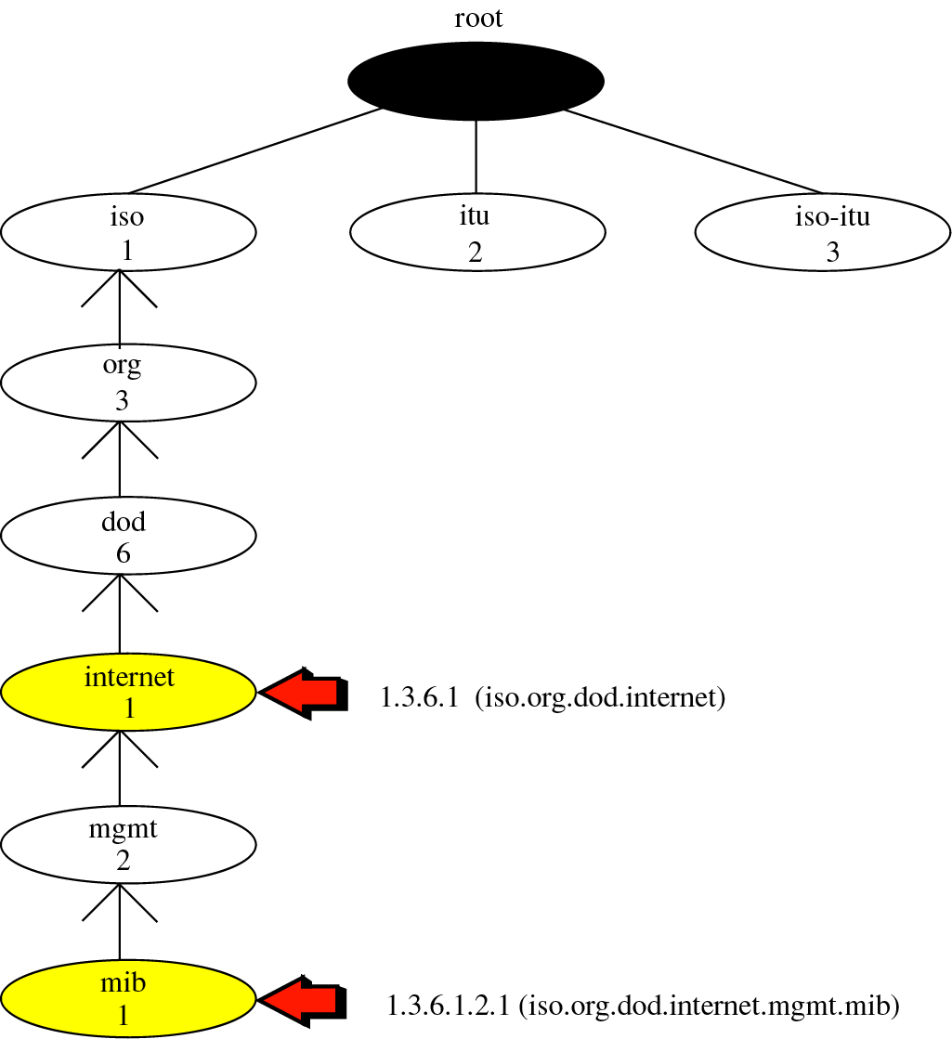
Figure 23-4
Object
identifier

Slide 15
All objects managed by SNMP
are given an object identifier.
The object identifier always starts
with 1.3.6.1.2.1.

Slide 16
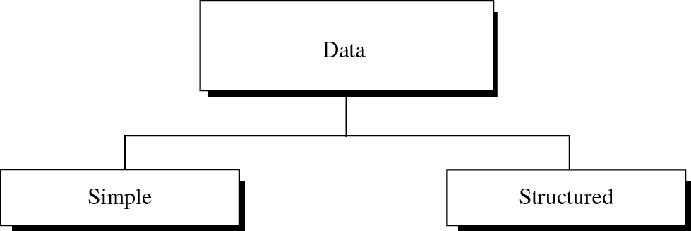
Figure 23-5
Data types

Slide 17
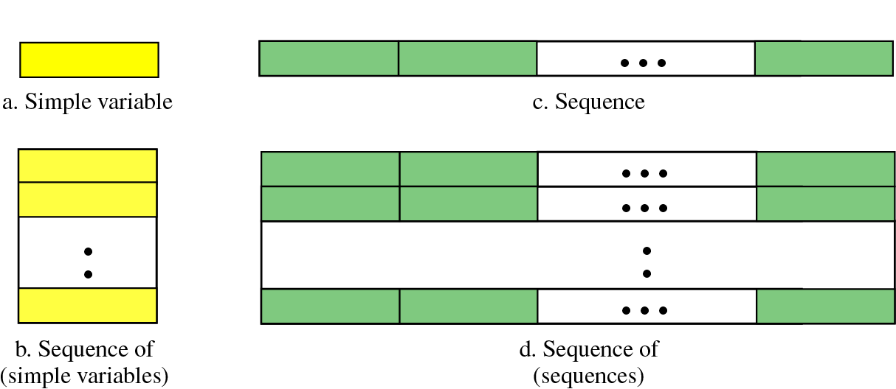
Figure 23-6
Conceptual data types

Slide 18
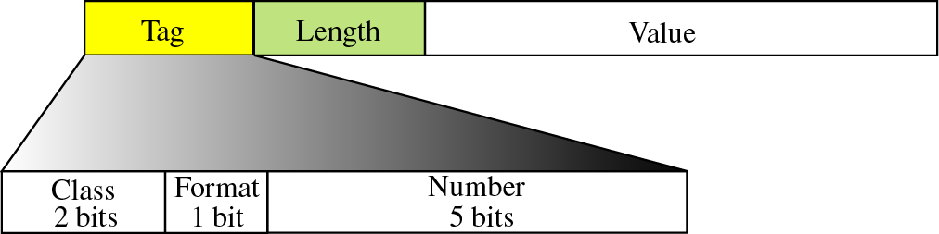
Figure 23-7
Encoding format

Slide 19
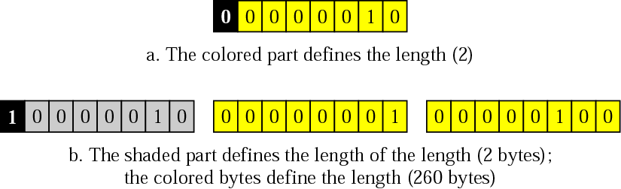
Figure 23-8
Length format

Slide 20
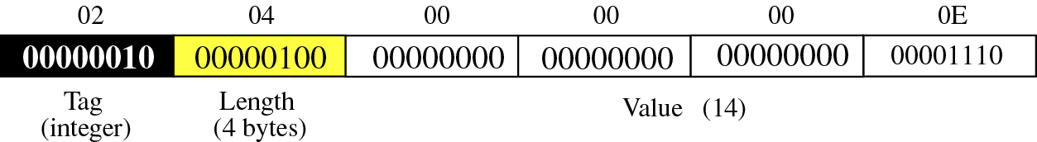
Figure 23-9
Example 1: INTEGER 14

Slide 21
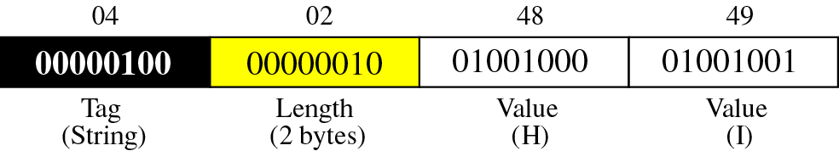
Figure 23-10
Example 2: OCTET STRING “HI”

Slide 22
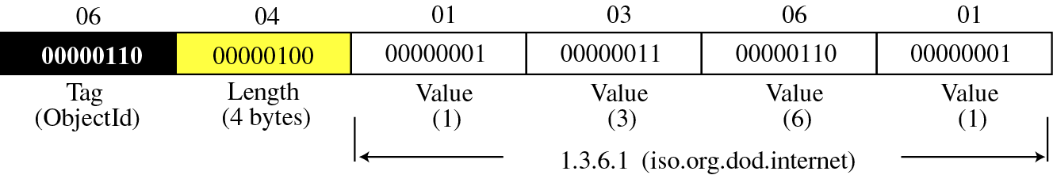
Figure 23-11
Example 3: ObjectIdentifier 1.3.6.1

Slide 23
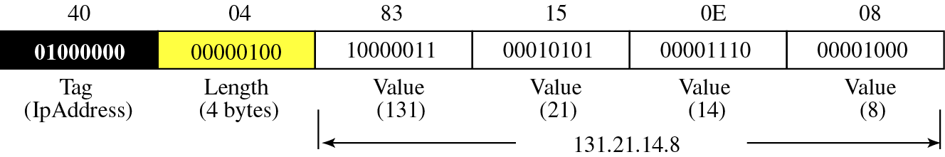
Figure 23-12
Example 4: IPAddress 131.21.14.8

Slide 24
23.4
MIB

Slide 25
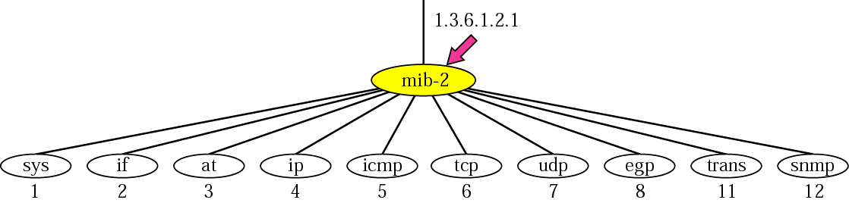
Figure 23-13
mib-2

Slide 26
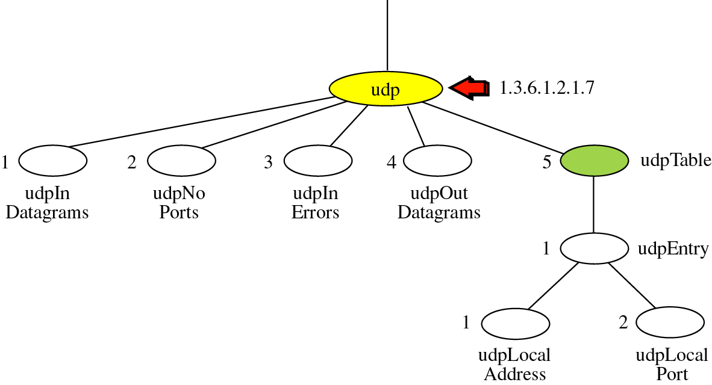
Figure 23-14
udp group

Slide 27
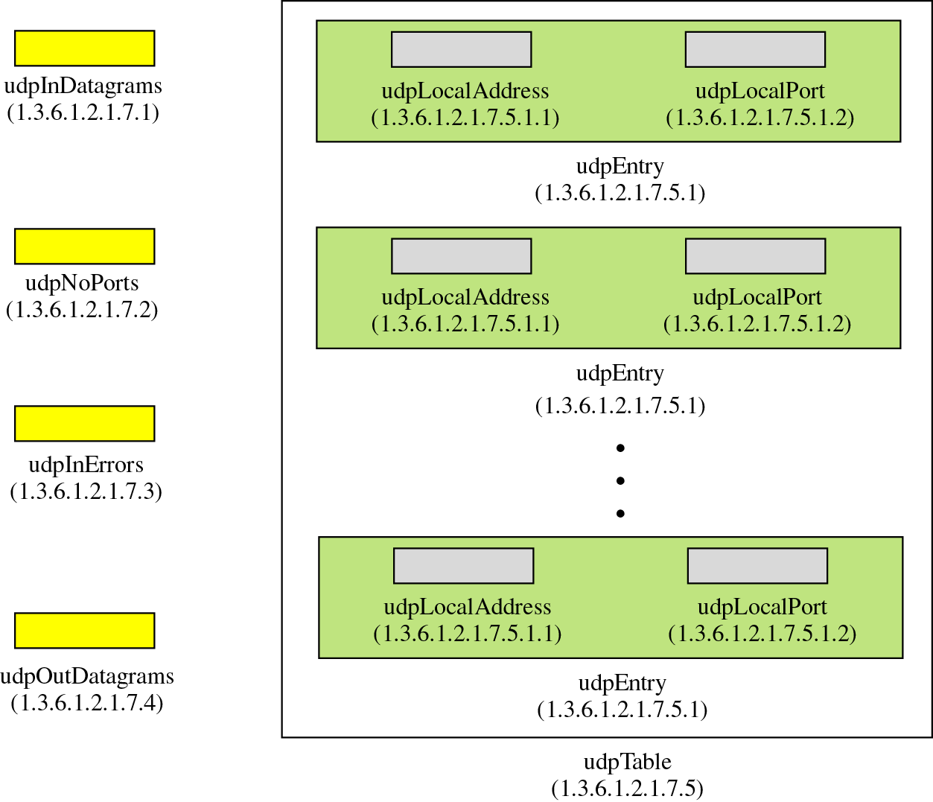
Figure 23-15
udp variables and tables

Slide 28
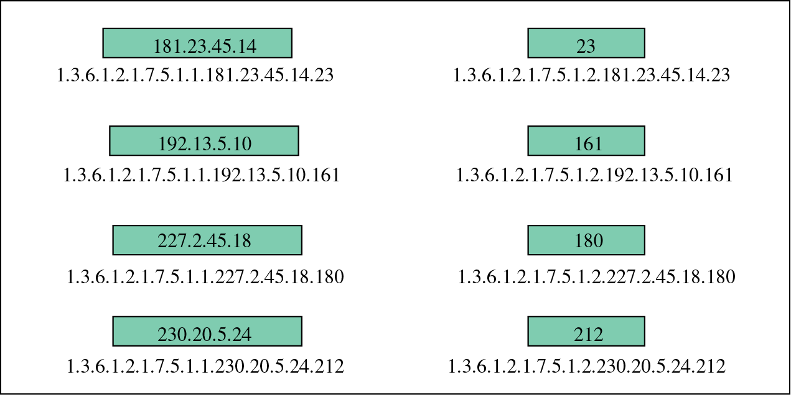
Figure 23-16
Indexes for udpTable

Slide 29
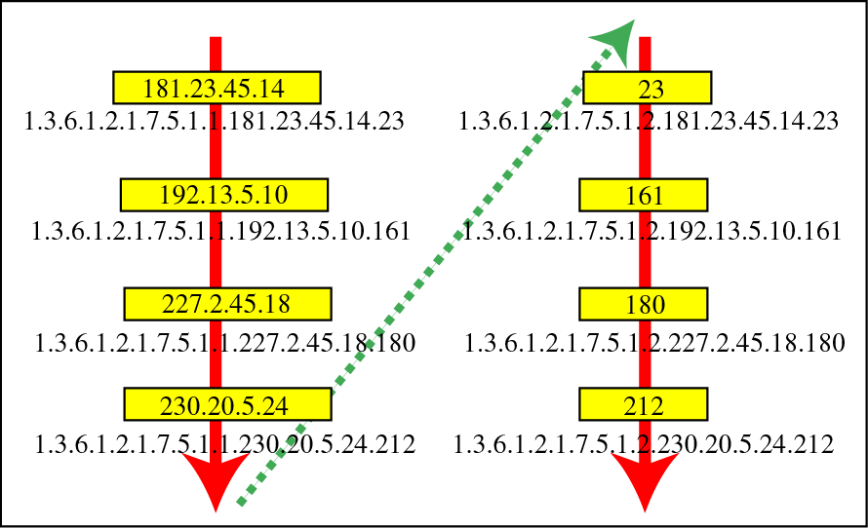
Figure 23-17
Lexicographic ordering

Slide 30
23.5
SNMP

Slide 31
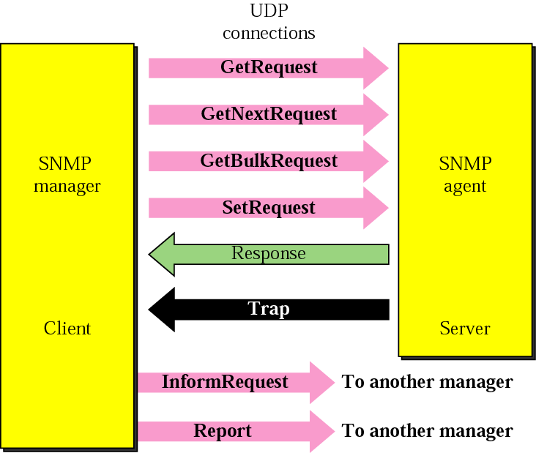
Figure 23-18
SNMP PDUs

Slide 32
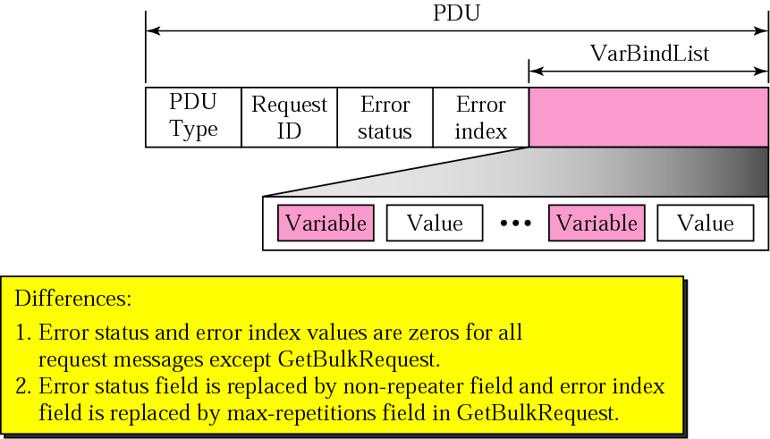
Figure 23-19
SNMP PDU format

Slide 33
23.6
MESSAGES

Slide 34
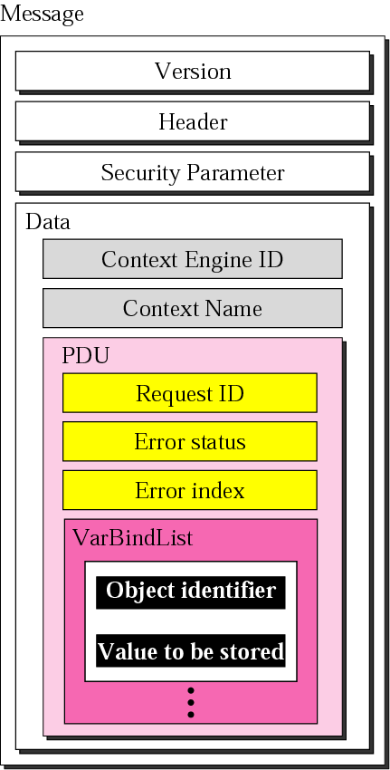
Figure 23-20
SNMP
message

Slide 35
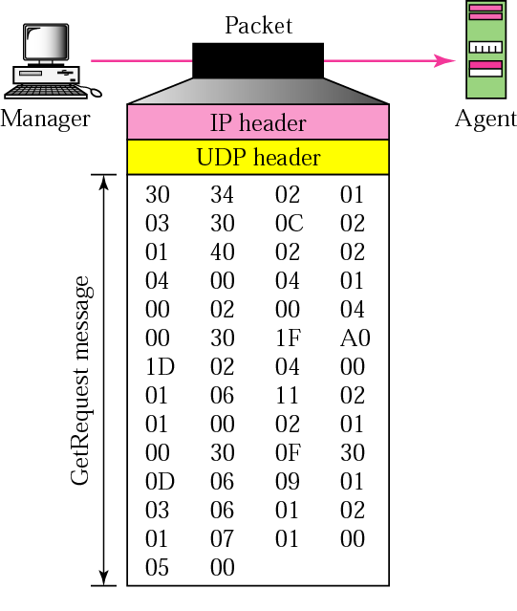
Figure 23-21
GetRequest
message

Slide 36
23.7
UDP
PORTS

Slide 37
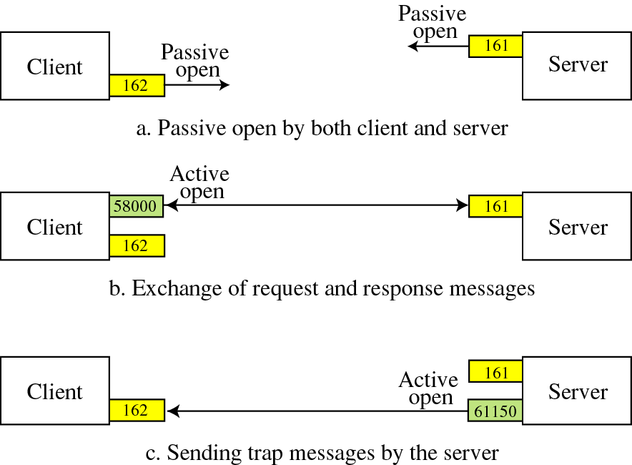
Figure 23-22
Port numbers for SNMP

Slide 38
23.8
SECURITY

